Slide 3
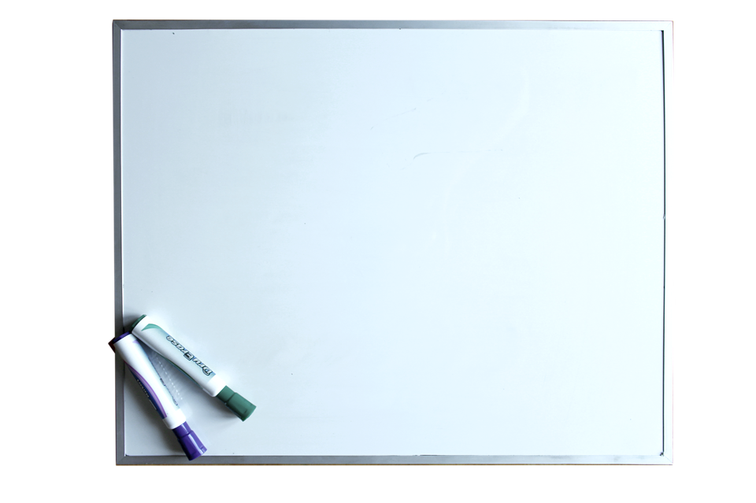

Slide 4
Now Let’s Get Our Thinking Caps On And Be Clever!!!!

